Slide 1

Senior Design Project I
Week 10: Design of Sign AI, an AI-Based ASL Translation Tool
Presenter: Josheb P. Dayrit
Notes:
Week 10 presentation = revision of week 9 presentation.

Slide 2

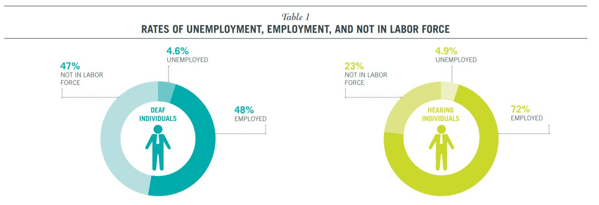
Background & Motivation
Employment of deaf persons
Source: Deaf People and Employment in the United States (2016), National Deaf Center on Post-Secondary Outcomes
Notes:
Disabilities come with unique set of hardships; hardships = setbacks.
Doesn’t matter if you’ve lost limbs, or if you’re deaf… Disability = hard to fully integrate in society.
This is especially apparent for deaf people if you look at the statistics about them.

Slide 3
Background & Motivation
Employment of deaf persons
Source: Deaf People and Employment in the United States (2016), National Deaf Center on Post-Secondary Outcomes
Notes:
National Deaf Center = compares labor force participation deaf vs non-deaf
What causes the disparity? Answer lies in type of disability.
For deaf = not able to speak properly, speech = product of tongue and ears

Slide 4
Background & Motivation
Employment of deaf persons
Source: Deaf People and Employment in the United States (2016), National Deaf Center on Post-Secondary Outcomes
Notes:
Deafness = cannot pursue specific career paths, ASL not widely used, hard to communicate

Slide 5
Objective
The gist
Design of an ASL translation tool that can enable deaf persons to have basic conversations with non-deaf persons.

Slide 6
Design Requirements
The Must-Haves
Non-Physical | Physical
Word-based translation | TTS (text-to-speech) function
Number of words: 100 words | STT (speech-to-text) function
Translation accuracy: 90 percent | LCD display for STT outputs

Slide 7
Design Constraints
Limitations
Hardware | Software | ASL | Financial
Needs connection to power | Voice synthesizer may sound inhuman and incomprehensible to some | Some “ASL gestures” are not hand-based (not measurable by sensors) | Budget: $300
Noise will adversely affect STT | Internet connection required

Slide 8
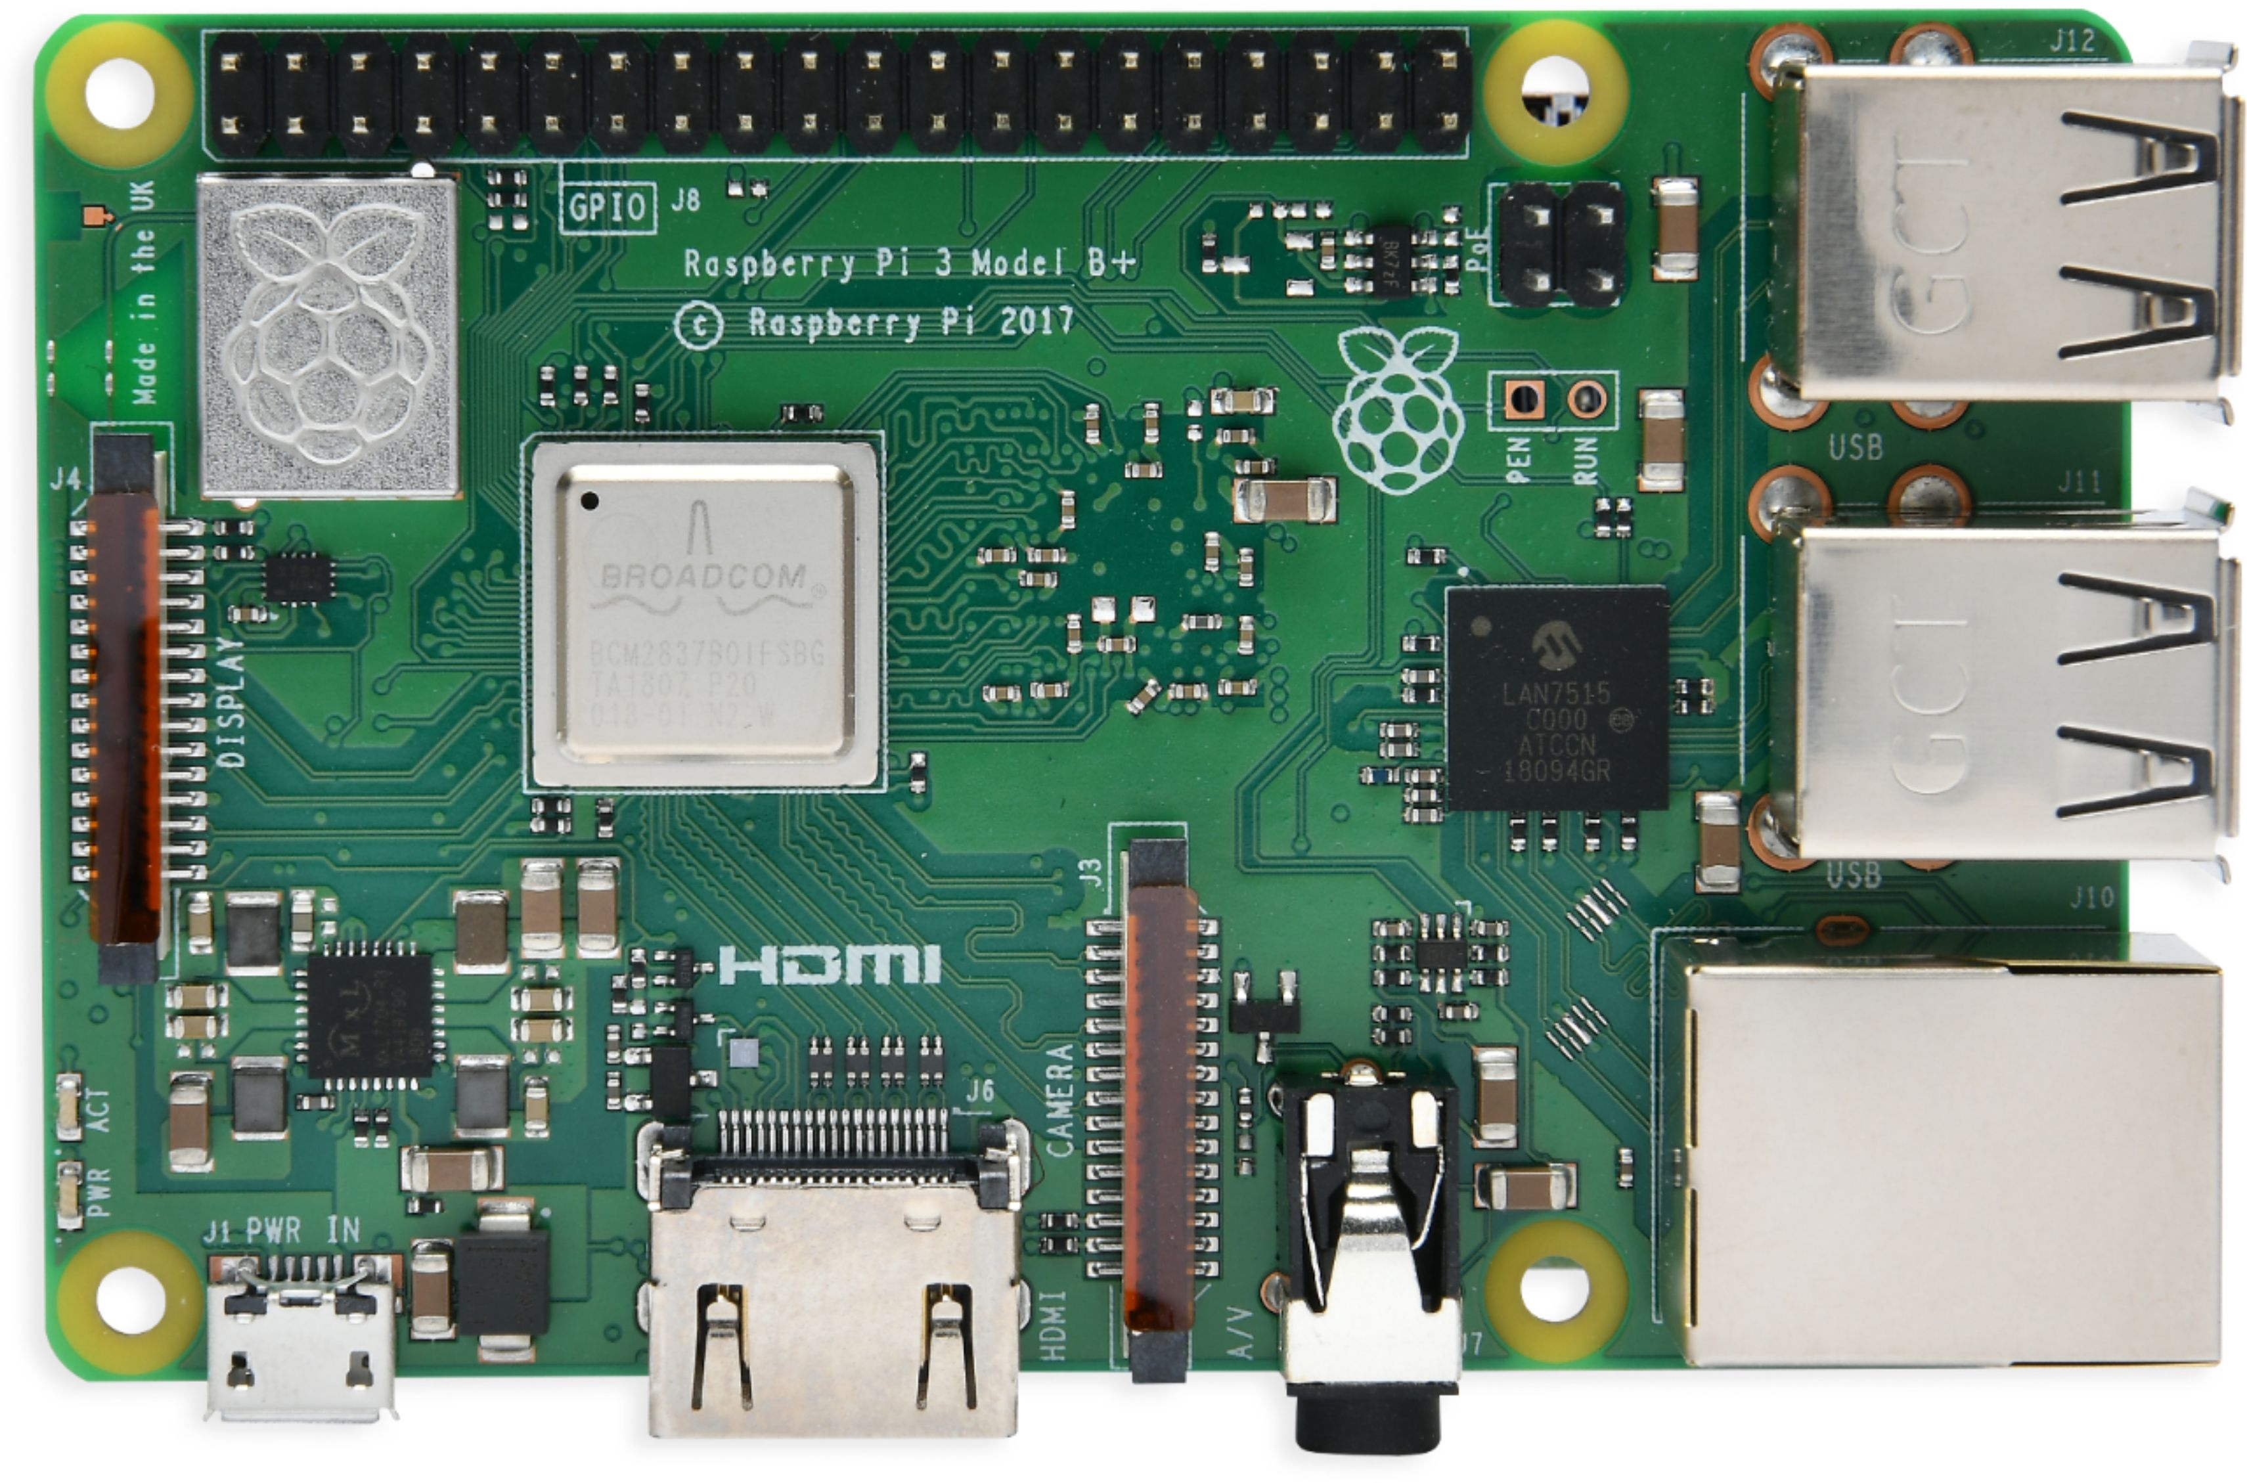
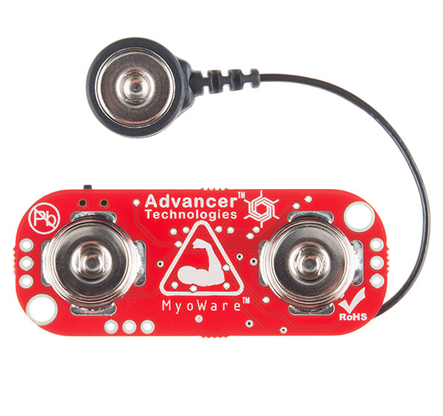
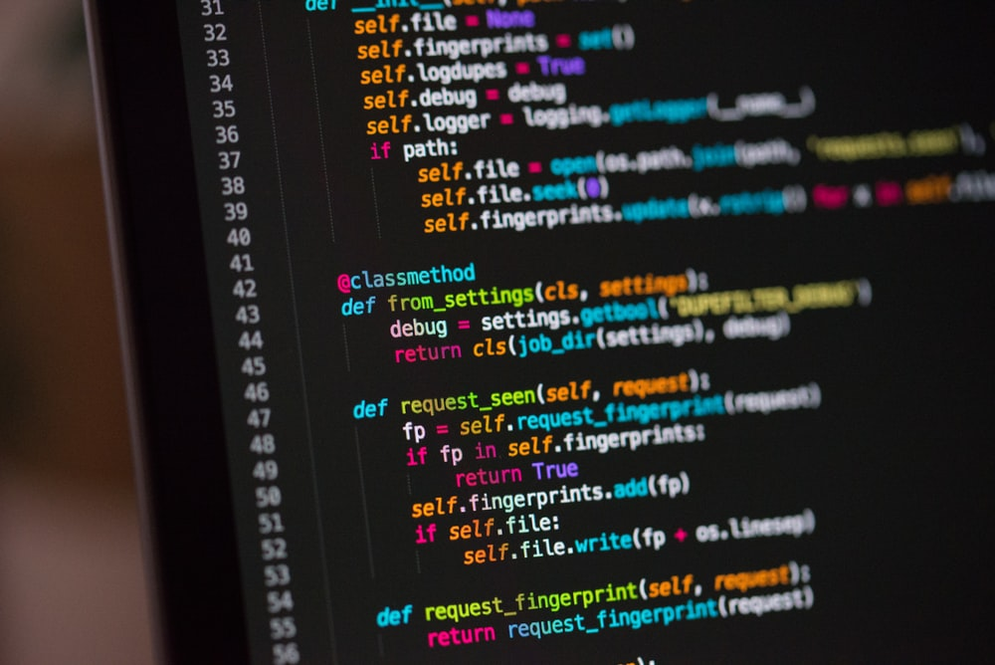
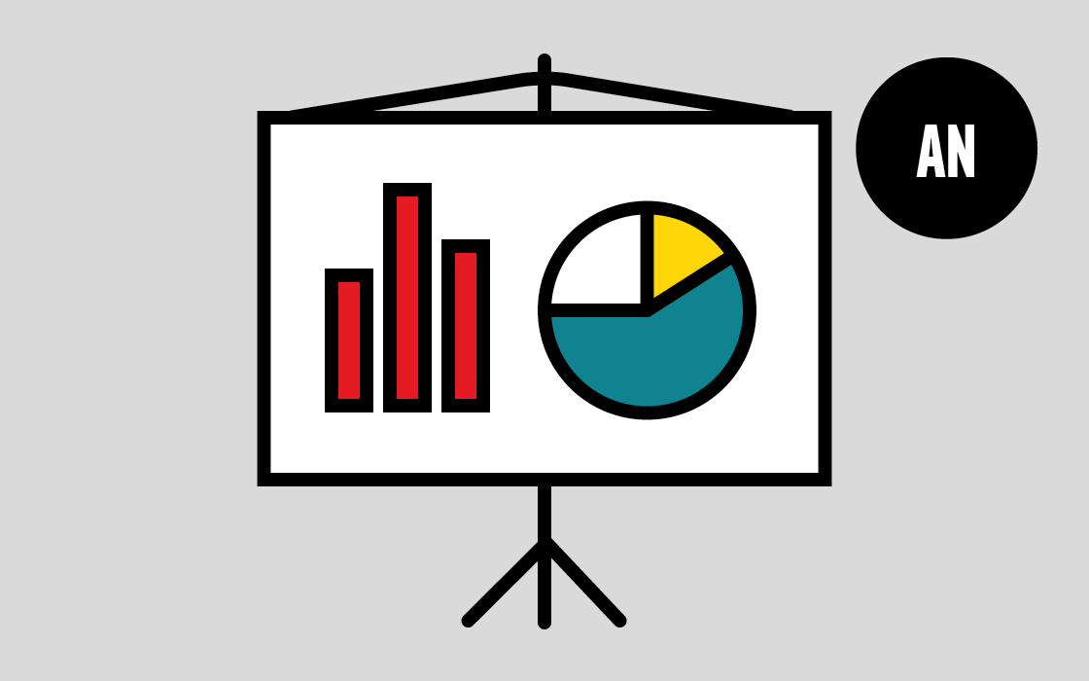


Design Approach
Step 1: Data Collection and Processing
Sensor Data
Graphs
Data Visualization Script
You

Slide 9
Design Approach
Step 2: Prepping Data for AI
Graphs
Arrays

Slide 10




Design Approach
Step 3: Designing AI
Neural Net
Neural Net
Type?
Layers?
Activation?

Slide 11
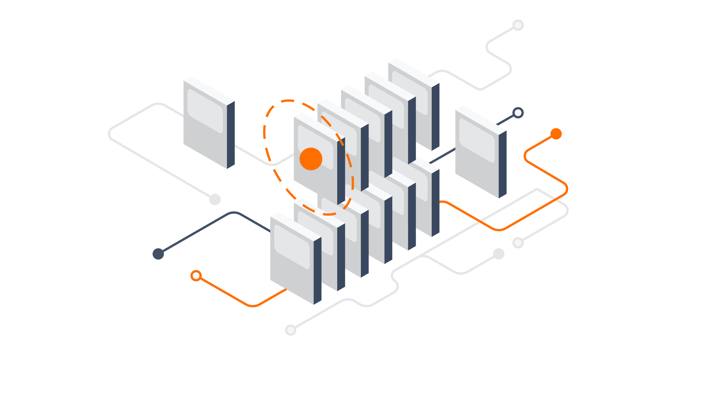



Design Approach
Step 4: Training AI
Refinement
TensorFlow
Neural Net
Accuracy
Training Data

Slide 12
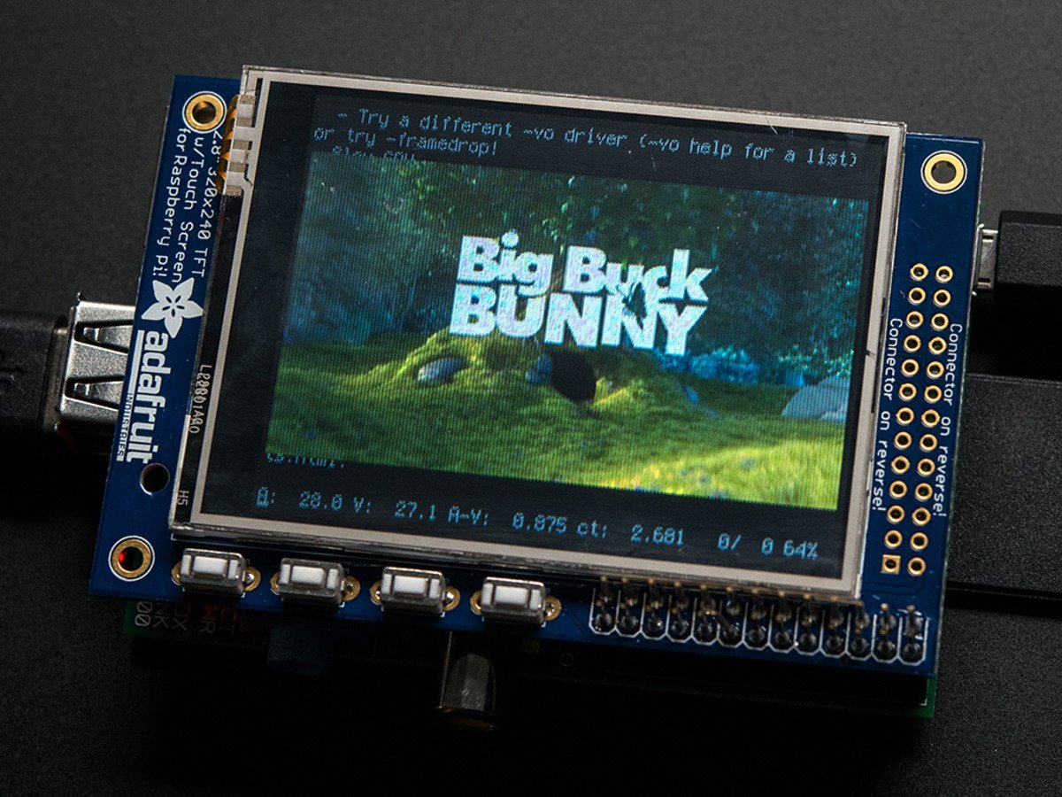
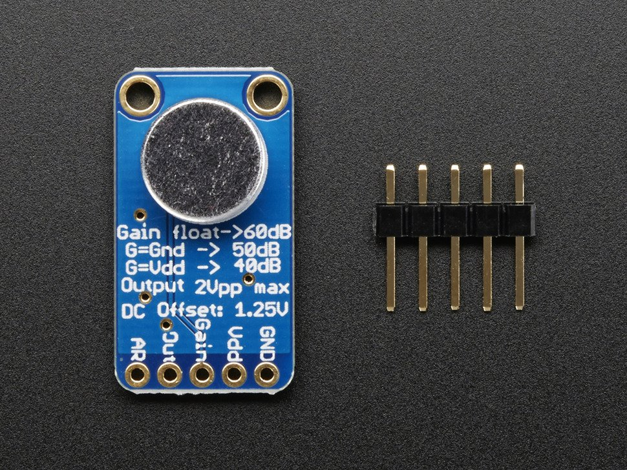
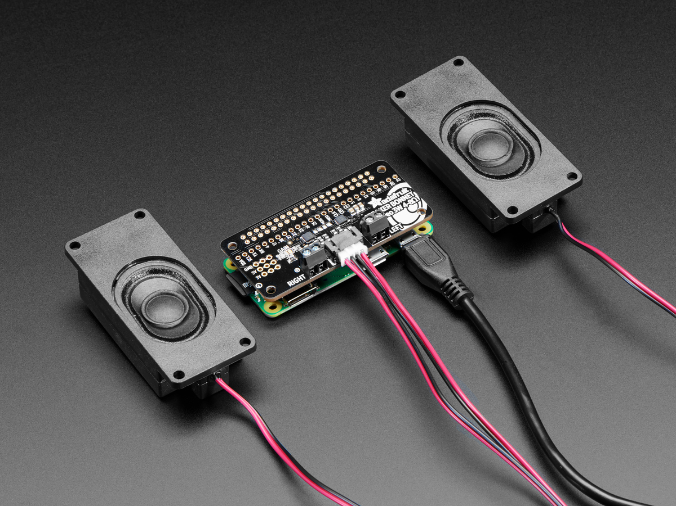
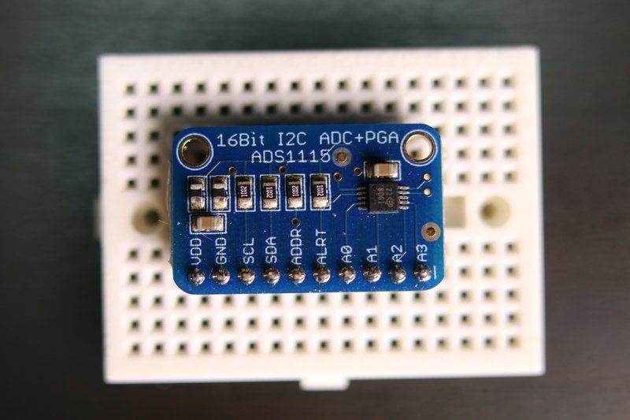
Design Approach
Step 5: Assembly of Parts
LCD Display
Raspberry Pi 3
Microphone
Speaker
ADC Converter
Sensors
Neural Net

Slide 13
System Description
Sensor-to-Pi Interface:
Analog
Digital
Sensors
ADC Converter
Raspberry Pi 3

Slide 14

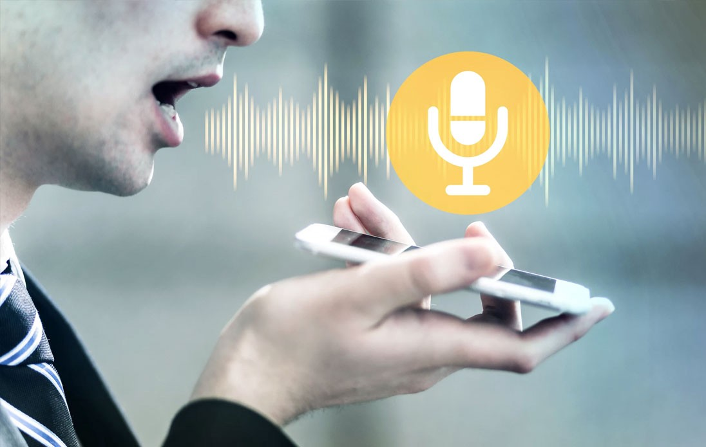
System Description
Mic-to-Display Interface:
Raspberry Pi 3
Audio
.wav/.mp3
Words
Text File
Microphone
Audio-to-Word Conversion
LCD Display
Speech-to-Text Software

Slide 15
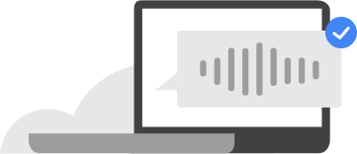
System Description
AI-to-Speaker Interface:
Raspberry Pi 3
Word
.wav/.mp3
Neural Net
Word-to-Audio Conversion
Speaker
Text-to-Speech Software

Slide 16
System Diagram
TTS Software
LCD Display
STT Software
Microphone
Raspberry Pi 3
Speaker
ADC Converter
Sensors
Neural Net

Slide 17
Task list
An overview
Task 1: Design and execute a general plan for image-based classification through a TensorFlow model using pseudo-data as training data.
Task 2: Collect and format real sensor data.
Task 3: Develop and train a TensorFlow model based on the normalized sensor data, and monitor training accuracy.
Task 4: Test TensorFlow model.
Task 5: Refine TensorFlow model.
Task 6: Assemble all necessary hardware, then make connections between the hardware and software.

Slide 18
Subtasks
Task 1
Subtask 1.1: Write Python script to generate and plot pseudo-data; save as .png/.jpg.
Subtask 1.2: Transform plotted data into arrays of RGB values, then normalize arrays.
Subtask 1.3: Develop and train a TensorFlow model using the normalized arrays, and monitor training accuracy.
Subtask 1.4: Refine TensorFlow model.
Subtask 1.5: Export TensorFlow model for later use.

Slide 19
Subtasks
Task 2
Subtask 2.1: Set up Raspberry Pi for data collection.
Subtask 2.2: Recruit subjects for testing.
Subtask 2.3: Collect sensor data from recruited test subjects.
Subtask 2.4: Write a Python script to plot sensor data and save as .png/.jpg.
Subtask 2.5: Write a Python script to cycle through, transform, and normalize the plotted data into arrays of RGB values.

Slide 20
Subtasks
Task 3
Subtask 3.1: Transfer learning from TensorFlow model in Task 1 to a new model.

Slide 21
Subtasks
Task 6
Subtask 6.1: Interface TTS software with neural net and speaker through a Python script.
Subtask 6.2: Interface STT software with microphone and LCD display through a Python script.

